Slide 1
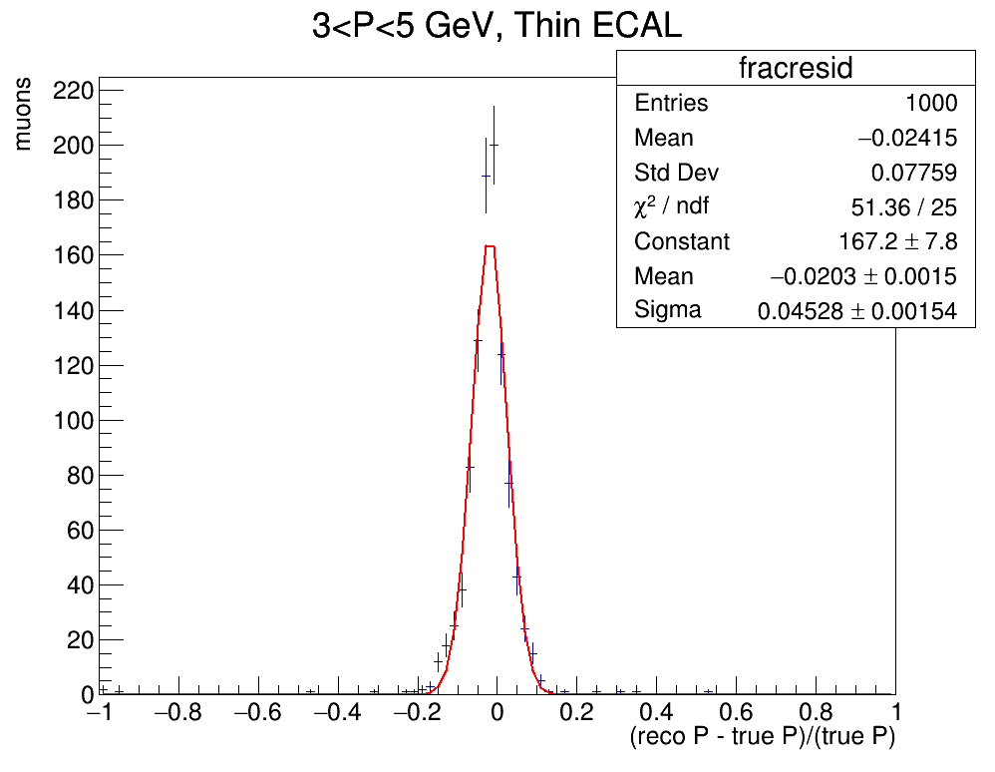
SIMULATION EXERCISE
Muon resolution garsoft simulation: 1000 randomly generated upstream muons entering the Gas TPC with initial momentum 3<P<5 GeV
Simulation Goal: Reconstruct the muon momenta and produce a reconstruction resolution plot
Exercise goal: Reproduce the resolution plot with a new randomly generated muon set
Graph produced with Tom’s original hemanatree.root file

Slide 2
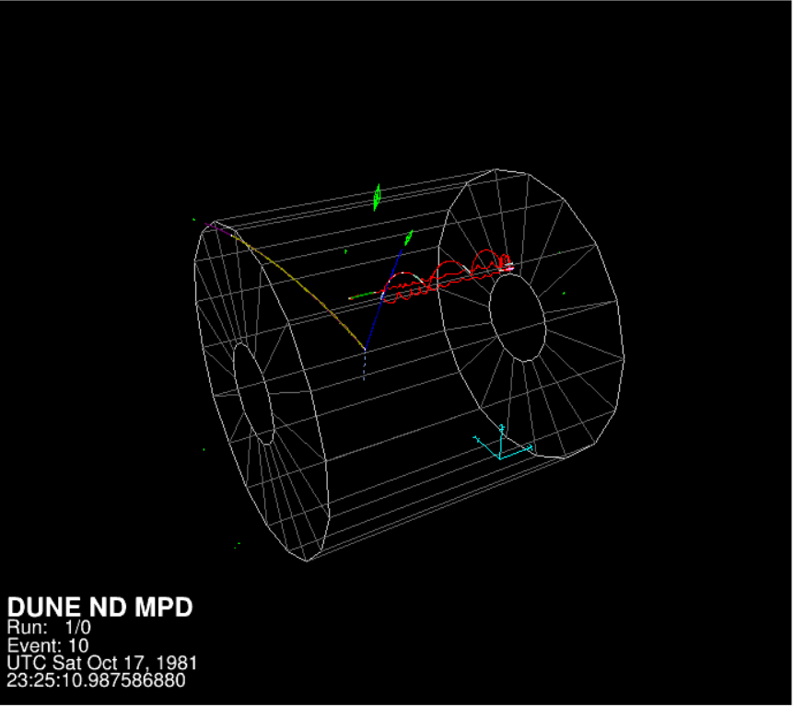
THE GARSOFT TUTORIAL
To familiarise with garsoft I firstly followed the garsoft tutorial which consists of four steps:
1000 Event sample generation via GENIE MC generator (prodgenie.fcl)
Readout simulation (readoutsimjob.fcl)
Reconstruction (recojob.fcl)
Creation of a simplified analysis root tree (anajob.fcl)
Event from the tutorial production visualiased with garsoft visual display (evd.fcl)

Slide 3
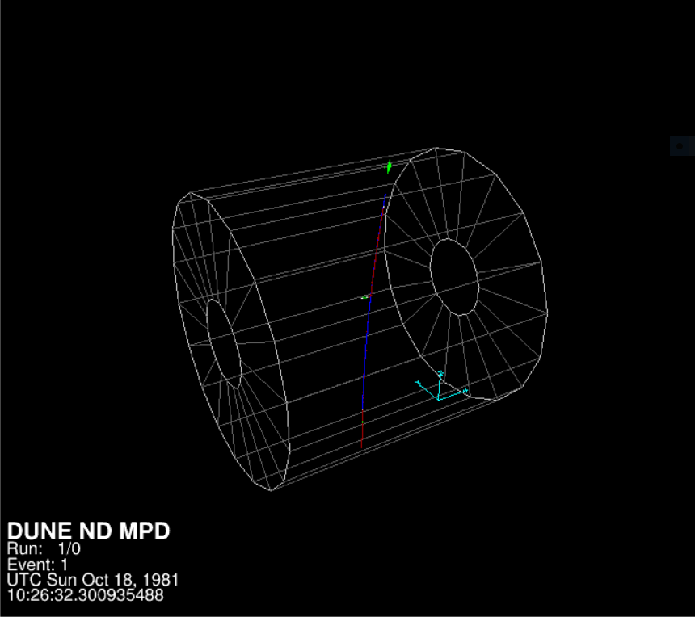
REPRODUCING TOM’S SIMULATION
Generate a text file (using Tom’s root macro) with instructions to produce 1000 upstream muons entering the Gar detector : initial momentum on the z direction(i.e. parallel to flux) that varies between 3 GeV and 5 GeV respectively; fixed z coordinate at 1000 cm (in the ND hall coordinates) ; x and y coordinate that vary between -200 and 200 cm and -200 and 0 cm respectively
Generate simulation using text file (different from Garsoft tutorial)
Execute readout simulation, reconstruction and convert into analysis tree (same as GarSoft tutorial)
Use root macro to produce resolution plot and compare with Tom’s
Upstrem muon visualised with garsoft visual display (evd.fcl)

Slide 4
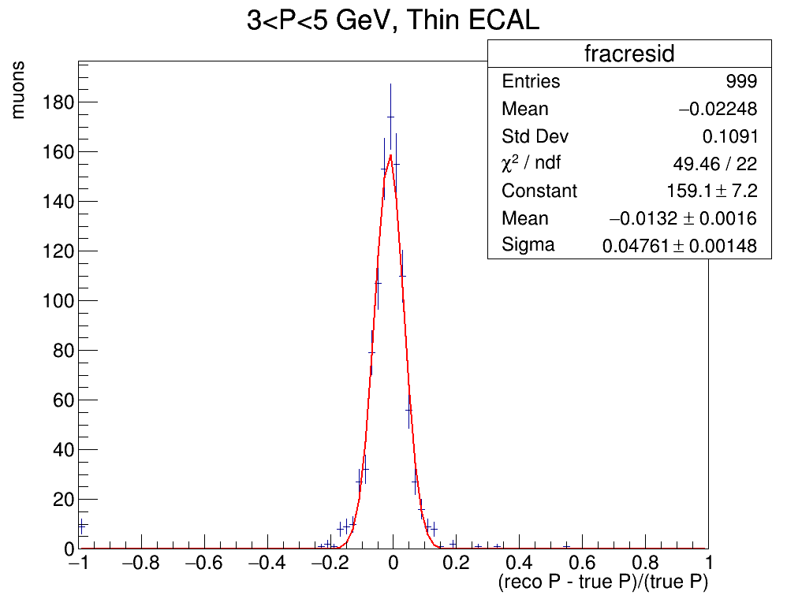
PLOTS COMPARISON
Graph produced with Tom’s original hemanatree.root file
Graph produced rerunning Tom’s simulation on preinstalled garsoft v2_05 mantaining initial muon sample
Graph produced rerunning Tom’s simulation on preinstalled garsoft v2_05 with different random muon sample

Slide 5
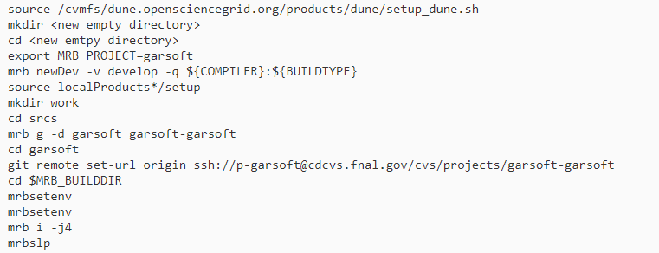
BUILD UP TO DATE GARSOFT VERSION
Tried building garsoft v3_05_01 with compiler e19 in debug mode following the garsoft getting started guide:
Note: Compiled and built with no errors

Slide 6
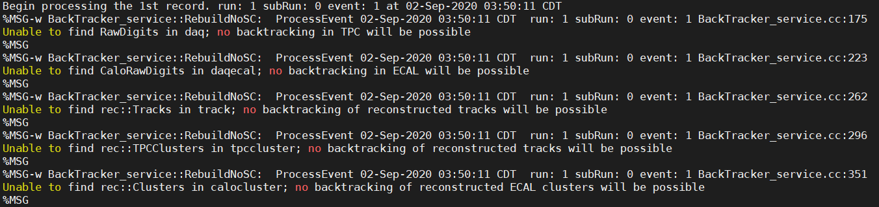
BUILD UP TO DATE GARSOFT VERSION
Repeated the simulation steps getting warning on readout simulation step:

Slide 7
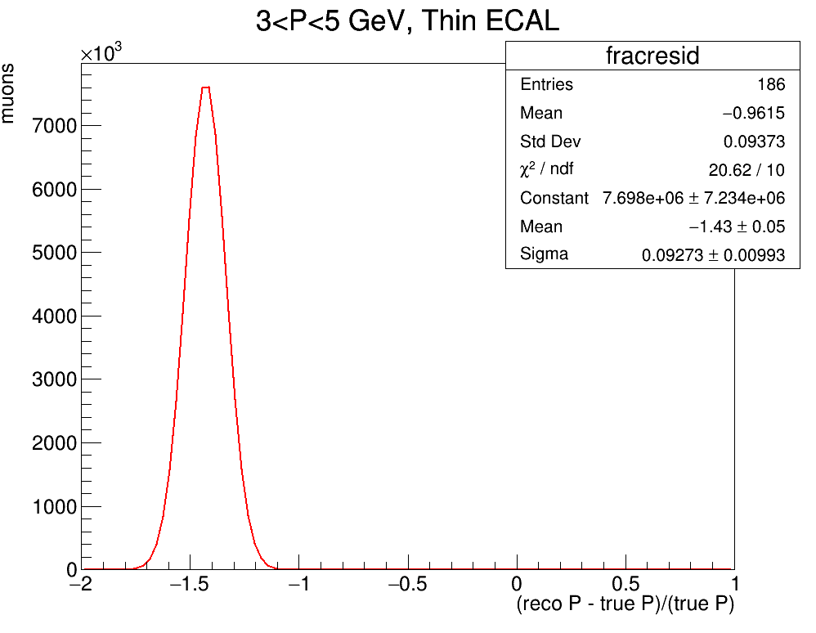
PLOTS COMPARISON
Graph produced rerunning Tom’s simulation on preinstalled garsoft v2_05 with new random muon sample
Graph produced rerunning Tom’s simulation on garsoft v3_05_01 with same new random muon sample (Many events missing and very small reconstructed momentum)

Slide 8
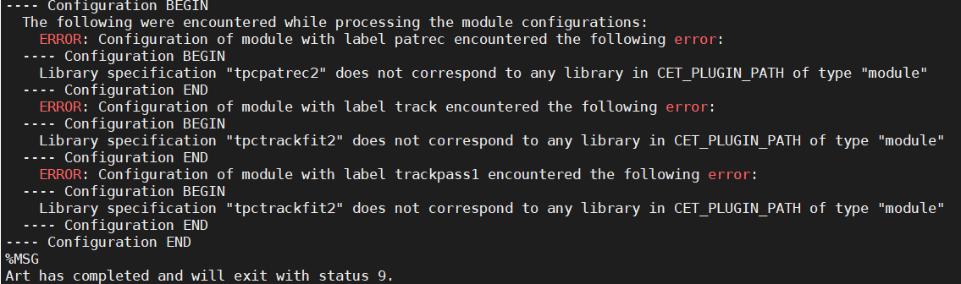
BUILD UP TO DATE GARSOFT VERSION
Tried with prof version (1/09 morning) and got this error:
Leo found the bug and fixed it

Slide 9

BUILD UP TO DATE GARSOFT VERSION
Tried again (2/09 morning) and got this new error when trying mrbsetenv
These messages might be related:
Obtained after:
mrb newDev -v v3_05_01 -q e19:prof
Obtained after:
mrb g -d garsoft garsoft-garsoft

Slide 10
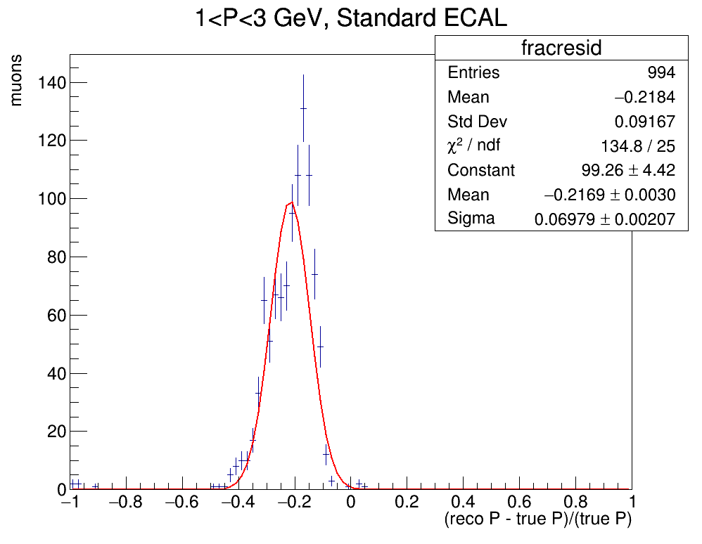
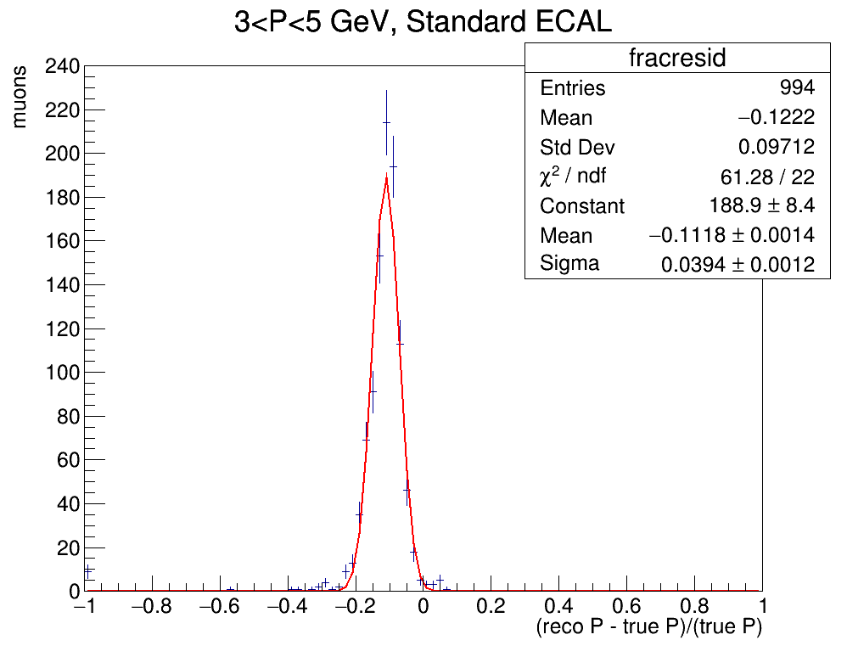
RESOLUTION (SAMPLE OUTSIDE THE DETECTOR)
Was finally able to install garsoft v3 successfully and to produce these resolution graphs
Resolution plot produced on garsoft v3 with random low energy muon sample generated upstream outside the detector (z=-500)
Resolution plot produced on garsoft v3 with random low energy muon sample generated upstream outside the detector (z=-500)

Slide 11
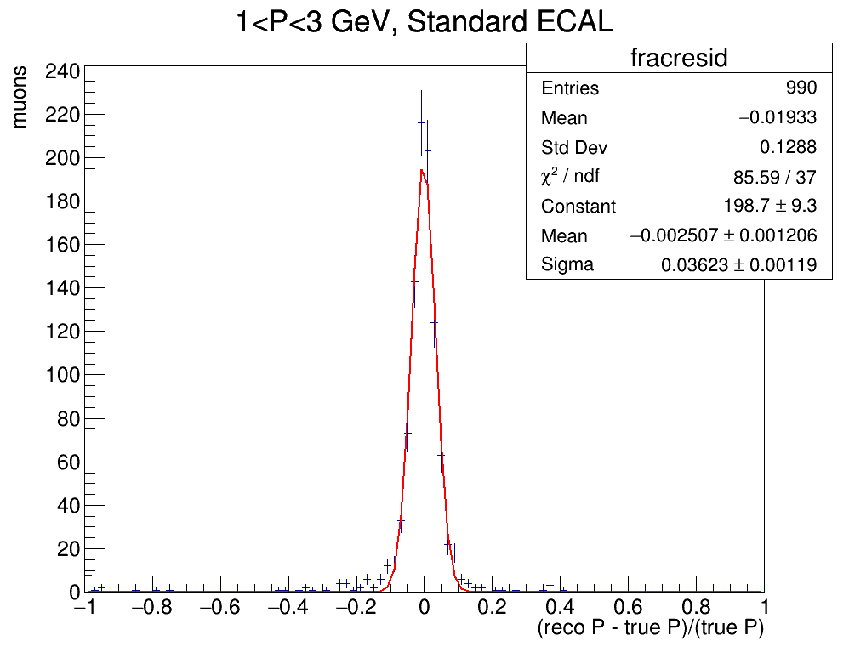

RESOLUTION (SAMPLE INSIDE THE DETECTOR)
To check if the resolution degradation was due to energy loss in calorimeter, I redid the simulation with a new muon sample generated inside the gas detector
Resolution plot produced on garsoft v3 with random low energy muon sample generated upstream inside the detector (z=-190)
Resolution plot produced on garsoft v3 with random low energy muon sample generated upstream inside the detector (z=-190)

Slide 12
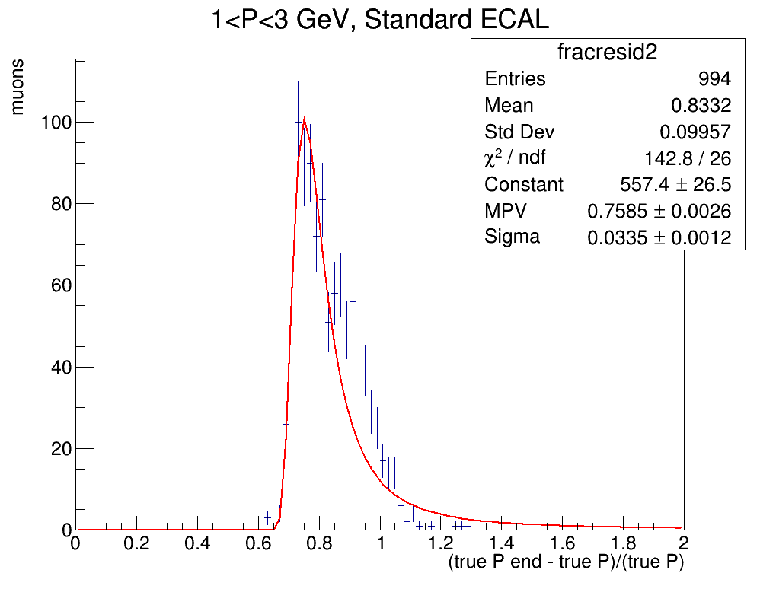
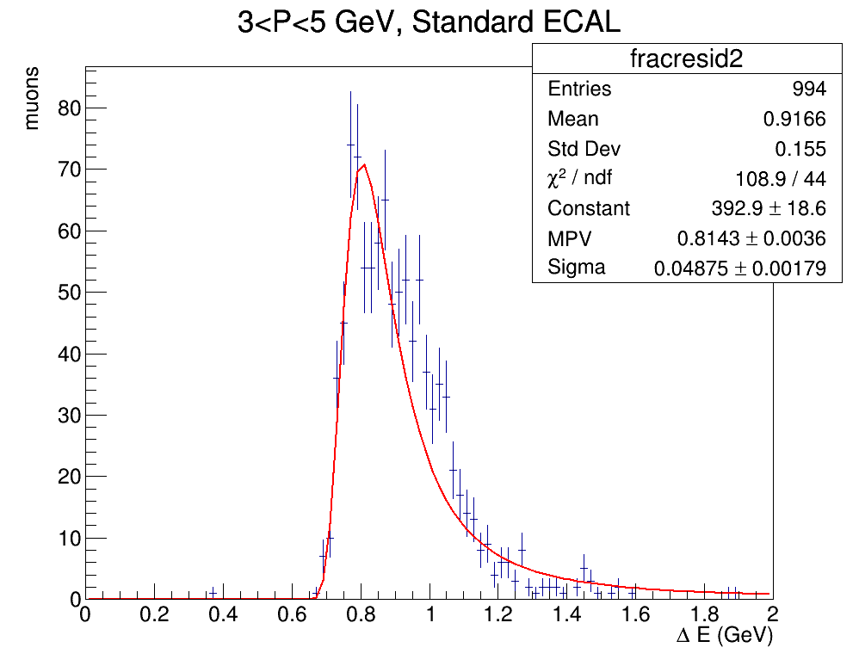

ENERGY LOSS PLOTS
Graphs for Energy loss distribution for the sample outside the detector
$$ΔE(GeV)$$
Energy loss plot produced on garsoft v3 with random low energy muon sample generated upstream outside the detector (z=-500)
Energy loss plot produced on garsoft v3 with random high energy muon sample generated upstream outside the detector (z=-500)

Slide 13
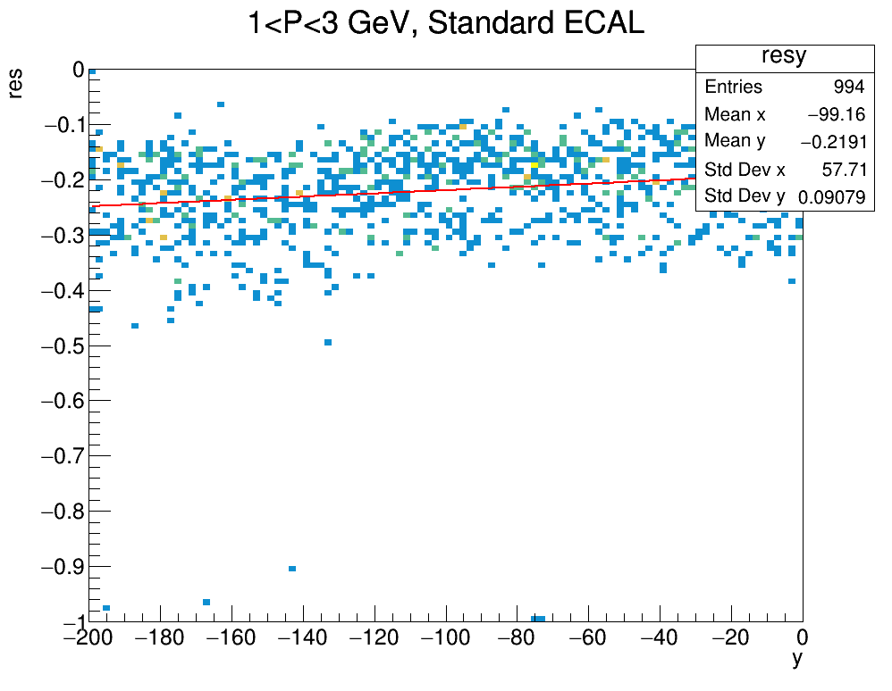
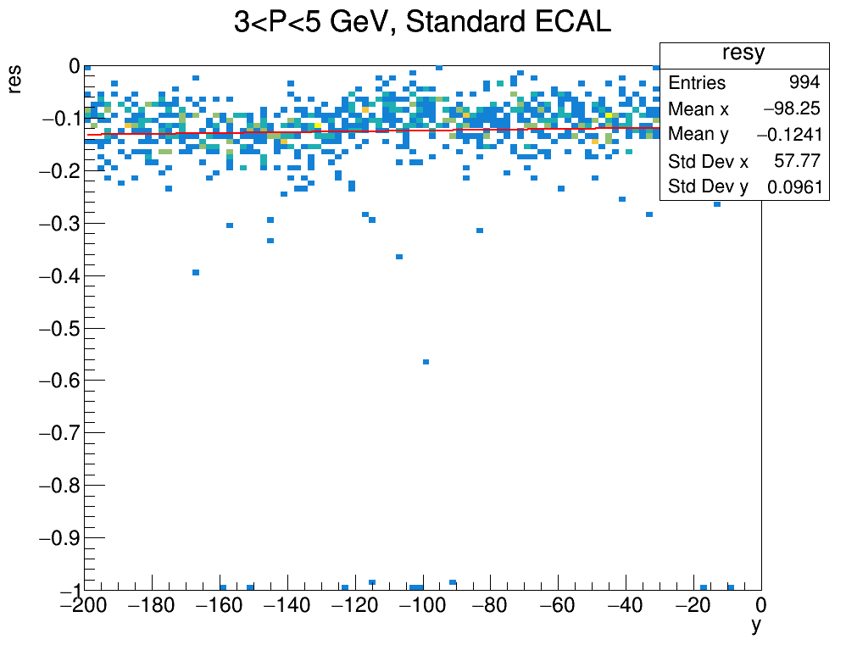
Resolution as a function of y
Plots of resolution as a function of the initial y (vertical) position of the muon ( random upstream samples outside the detector -200 cm < y < 0 cm )

Slide 14
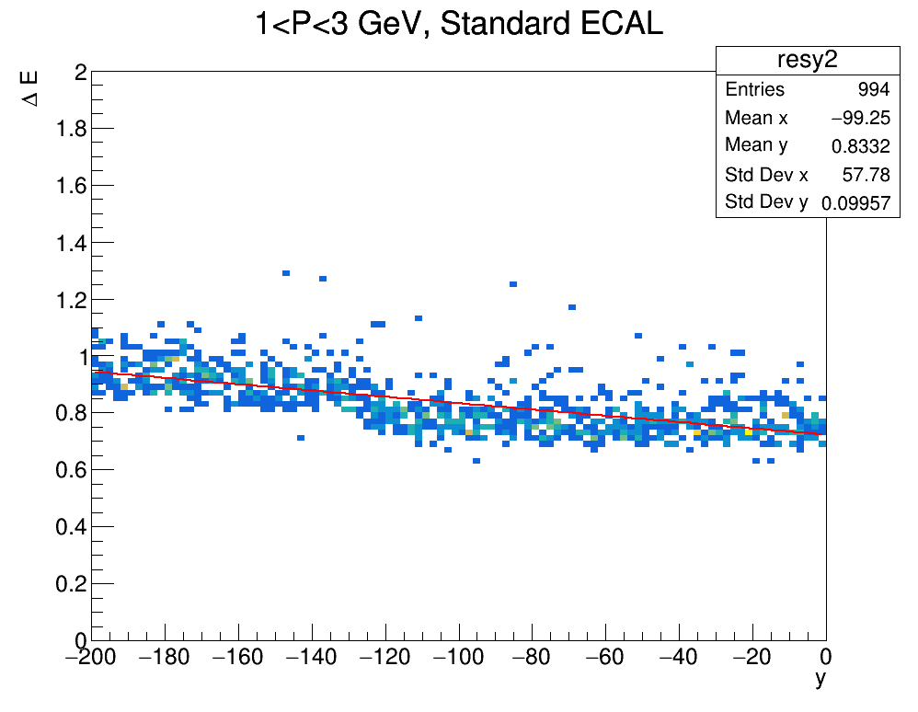
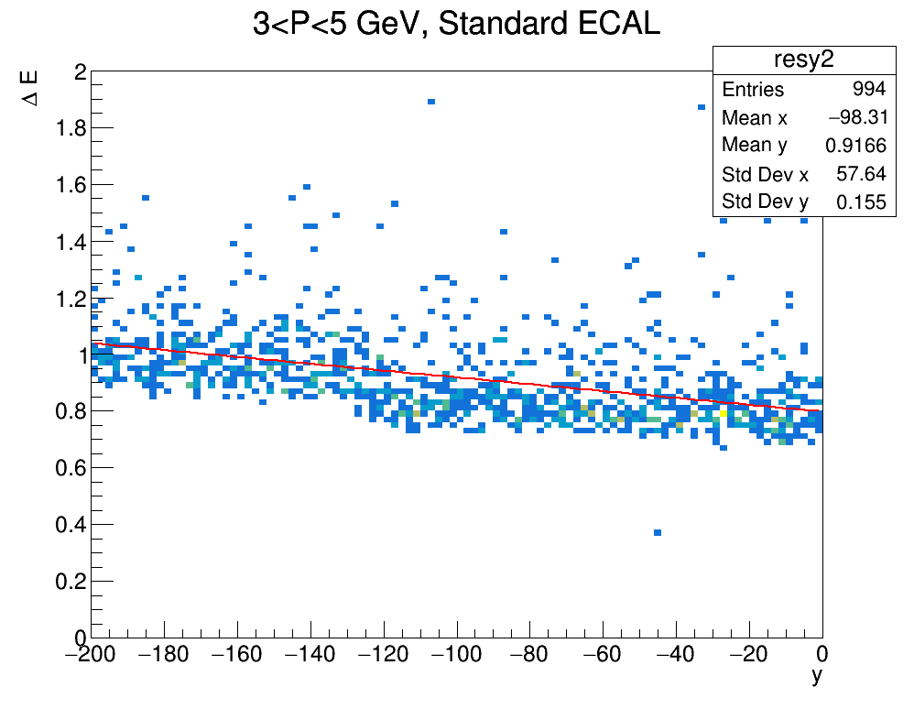
ENERGY LOSS as a function of y
Plots of energy loss $ΔE(GeV)$ as a function of the initial y (vertical) position of the muon ( random upstream samples outside the detector -200 cm < y < 0 cm )

Slide 15
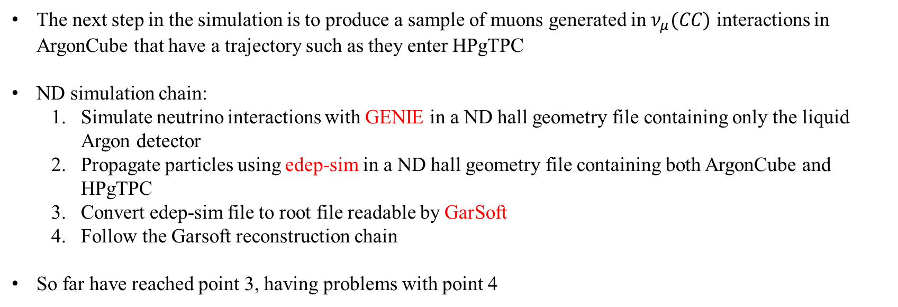
NEXT step in the simulation
The next step in the simulation is to produce a sample of muons generated in $ν_{μ}(CC)$ interactions in ArgonCube that have a trajectory such as they enter HPgTPC
ND simulation chain:
Simulate neutrino interactions with GENIE in a ND hall geometry file containing only the liquid Argon detector
Propagate particles using edep-sim in a ND hall geometry file containing both ArgonCube and HPgTPC
Convert edep-sim file to root file readable by GarSoft
Follow the Garsoft reconstruction chain
So far have reached point 3, having problems with point 4

Slide 16
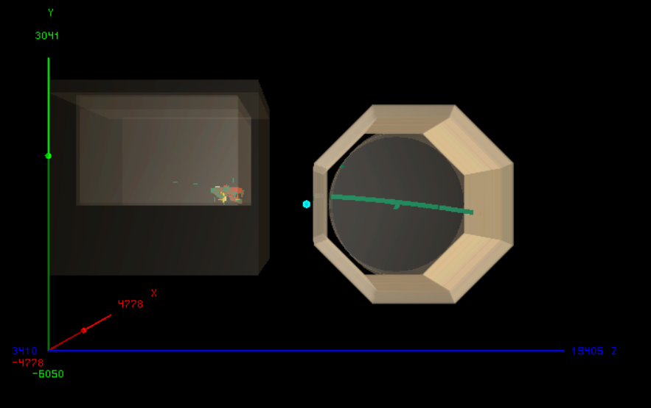
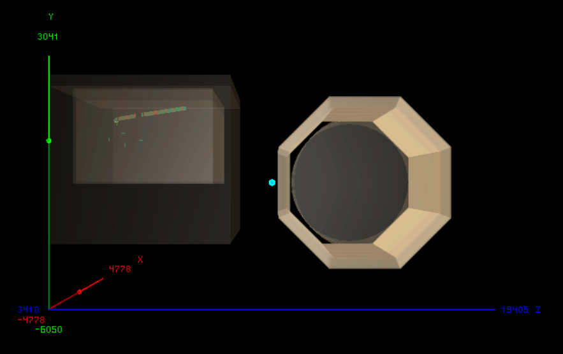
Edep-display examples
Two graphical representations of $ν_{μ}(CC)$ interactions in ArgonCube made with edep-sim event display. In one the muon enters the gas TPC, in the other it does not
PASSING MUON
NON-PASSING MUON

